Slide 1
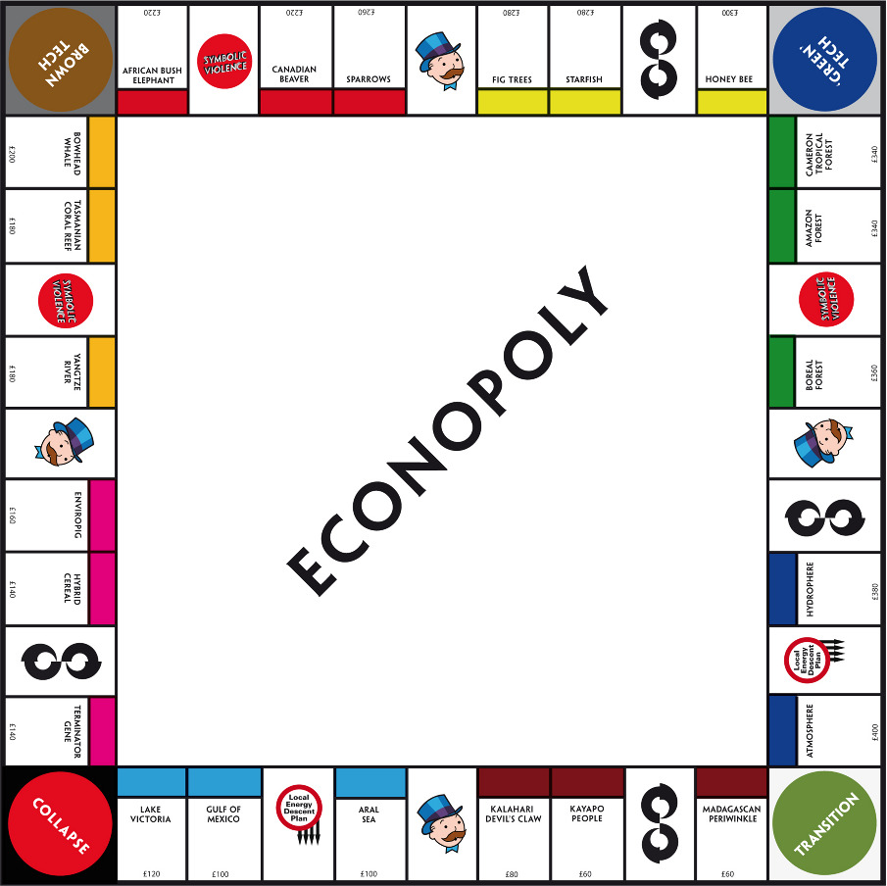
Welcome to Year 8 Economics and Business!
Miss Sheridan

Slide 2





After lesson

Slide 3

The #1 Rule!

Slide 4


My preference is for you to do
ALL work in an exercise book.
This allows me to:

Slide 5
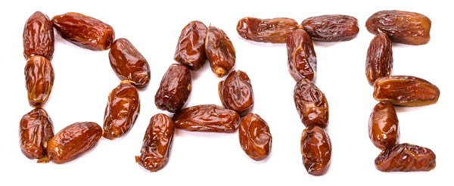



Slide 6



Slide 7



Does a word have you stumped?
Add it to our class

Slide 8

Aim: To list the 6 key concepts of Economics and Business, and the 4 types of markets

Slide 9

Economics is a social science (study of human behaviour) that studies the decisions made by individuals, households, businesses, governments and other groups about how scarce resources are allocated in attempting to satisfy unlimited needs and wants.

Slide 10
Business is an organisation, enterprise or business engaged in the production and trade of goods and services, usually for profit.

Slide 11

Needs
Wants
A good or service that consumers consider necessary to maintain their standard of living
A good or service that is desired in order to provide satisfaction to the user, but which is not necessary for survival or to meet the basic standard of living in a community

Slide 12


Tangible items that satisfy needs and wants – they can be seen and touched
An intangible activity that satisfies needs and wants – it does not result in ownership

Slide 13

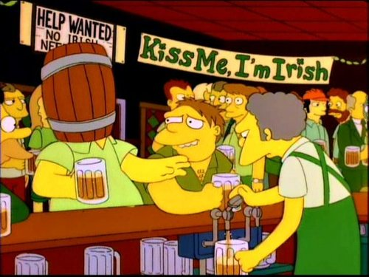
Good
Service

Slide 14

Review - 6 key concepts of economics and business

Slide 15

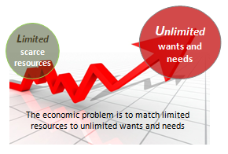
Scarcity
The economic problem of having unlimited needs and wants, but limited resources that can be used to achieve them.

Slide 16

Making Choices
The way consumers make choices about what they buy to satisfy needs and wants

Slide 17
Specialisation and Trade
Specialisation -Method of production where a business/area focuses on the production of a limited scope of products/services to gain greater efficiency
Trade – the activity of buying, selling or exchanging goods/services between people and/or countries

Slide 18
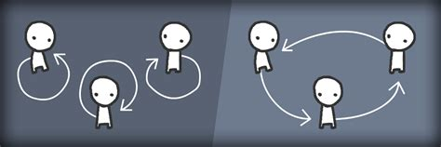
Interdependence
The way participants in an economy (such as individuals, businesses and governments) rely on each other to provide/trade the goods/services they can not produce themselves

Slide 19

Allocation and markets
Allocation – how we distribute scarce resources among producers
Markets – the exchange of resources/goods/ services among buyers and sellers

Slide 20

Economic performance and living standards
Economic performance – evaluating the performance of an economy, by measuring against economic objectives (ie. unemployment level)
Living standards- the level of wealth, material goods, comfort and life necessities available to people living in a geographical area

Slide 21

6 Key economics and business concepts
Using pages 300-303 of your textbook, investigate and record the key points of the 6 key concepts
(Scarcity, Making Choices, Specialisation and Trade, Interdependence, Allocation and Markets, Economic Performance, Living Standards).

Slide 22



You may use the table provided, or create your own graphic organiser (digital or by hand).
If you choose to create your graphic organiser on the computer it is your responsibility to print this for your workbook.
Remember: Name, Date and Heading

Slide 23


Exit Ticket
What do you think the relationship is between scarcity and making choices?
Hand your exit ticket in with name and class number before leaving

